Slide 1
Overview of AWT
AWT stands for Abstract Window ToolKit.
It is a portable GUI library between different platforms
The user interfaces provided by are implemented by using each platform’s native GUI interface
Package for AWT:
java.awt
Notes:
The Java programming language class library provides a user interface toolkit called the Abstract Windowing Toolkit, or the AWT. The AWT is both powerful and flexible.
The AWT was designed so that programmers don't have worry about the details of tracking the mouse or reading the keyboard, nor attend to the details of writing to the screen. The AWT provides a well-designed object-oriented interface to these low-level services and resources.
Because the Java programming language is platform-independent, the AWT must also be platform-independent. The AWT was designed to provide a common set of tools for graphical user interface design that work on a variety of platforms. The user interface elements provided by the AWT are implemented using each platform's native GUI toolkit, thereby preserving the look and feel of each platform. This is one of the AWT's strongest points. The disadvantage of such an approach is the fact that a graphical user interface designed on one platform may look different when displayed on another platform.
Java Programming Handouts

Slide 2
Components
A graphical user interface is built of graphical elements called components
Different Type of Components are
Choice
AWT Components
Label
TextBox
List
Etc….
Notes:
Components allow the user to interact with the program and provide the user with visual feedback about the state of the program. In the AWT, all user interface components are instances of class Component or one of its subtypes.
Java Programming Handouts

Slide 3


Container
Components are placed within Containers
Containers maintain the layout of the components
Panel
Applet
AWT Containers
Frame
Window
Dialog
Notes:
Components do not stand alone, but rather are found within containers. Containers contain and control the layout of components. In the AWT, all containers are instances of class Container or one of its subtypes
Java Programming Handouts

Slide 4
Container
Each Container comes with a default Layout Manager
What is Layout Manager???

Slide 5
Containers and Components
AWT
A GUI is built by putting components into containers
Container is to hold and display Components
Component are Button, Checkbox, Label, TextField, and TextArea
A Container is also a Component
Important Container classes are Frame, Applet, and Panel
  JFrame and JApplet both contain other containers; use getContentPane() to get to the container you want
  You typically create and use JPanels directly

Slide 6
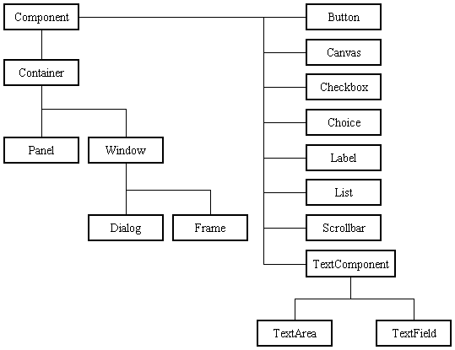
Hierarchy of AWT Container and Component
AWT
Cointainer is also an component
Notes:
The entire Component List is not mentioned
Dialog has a subclass FileDialog
Java Programming Handouts

Slide 7
To build a GUI...
AWT
Make somewhere to display things (a Container)
  Usually you would use a Frame or a Applet
Create some Components (buttons, text areas, panels, etc.)
  It’s usually best to declare Components as instance variables, and
  Define them in your applet’s init() method or in some application method
Add your Components to your display area
  Choose a layout manager if not than manage yourself.
  Add your Components to your JFrame or JApplet according to the rules for your layout manager
Attach Listeners to your Components

Slide 8
setLayout without managers
import java.awt.*; AWT PACKAGE
class NullLayoutDemo extends Frame { CREATE A CLASS EXTENDED FROM A FRAME--→ A CONTAINER
Button btn;
TextField txt; CREATE COMPONENT’S OBJECT
NullLayoutDemo(){
setLayout(null); SET LAYOUT TO 0 MEANS MANAGE MANUALLY
btn = new Button("OK"); GIVE THE REFERENCE TO THE COMPONENT AND A LABEL
btn.setSize(50,25); SET BUTTON X AND Y POSITIONS
btn.setLocation(25,100);
txt = new TextField("WELCOME TO JAVA"); CREATE A TEXTBOX
//txt.setSize(150,25);
//txt.setLocation(100,100);
txt.setBounds(75,100,300,20); ALTERNATE METHOD FOR X,Y,L,W OF A TEXTBOX
add(btn);
add(txt); ADD COMPONENTS TO THE CONTAINER
}
public static void main(String args[]) {
NullLayoutDemo demo = new NullLayoutDemo(); CREATE A OBJECT
demo.setSize(400,400); SET LENGTH AND WIDTH FOR FRAME
demo.setVisible(true); MAKE FRAME VISIBLE
}
}

Slide 9
Layout Manager
Layout Management is the process of determining the size and positions of the components.
BorderLayout
Types of Layout
Managers
FlowLayout
GridLayout
GridBagLayout
CardLayout
BoxLayout
Notes:
By default, each container has a layout manager -- an object that performs layout management for the components within the container. Components can provide size and alignment hints to layout managers, but layout managers have the final say on the size and position of those components
Java Programming Handouts

Slide 10
Layout Manager Hierarchy
javax.lang.Object
java.awt.BorderLayout
java.awt.FlowLayout
java.awt.GridBagLayout
java.awt.GridLayout
java.awt.CardLayout

Slide 11


Default Layout Manager of Containers
automatically arranges your controls within a window by using some type of algorithm.
Each Container object has a layout manager associated with it.
A layout manager is an instance of any class that implements the LayoutManager interface.
The layout manager is set by the setLayout( ) method.
void setLayout(LayoutManager layoutObj)
BorderLayout
FlowLayout
Window
Panel
What would be the Layout of Frame, Dialog and Applet????
All Component Classes are placed in
  java.awt package except Applet
The Applet container
is placed in
java.applet
Notes:
The Default of Frame is BorderLayout
The Default layout of Dialog is BorderLayout
The Default layout of Frame is FlowLayout
Every container, by default, has a layout manager -- an object that implements the LayoutManager interface.If a container's default layout manager doesn't suit your needs, you can easily replace it with another one. The Java platform supplies layout managers that range from the very simple (FlowLayout and GridLayout) to the special purpose (BorderLayout and CardLayout) to the very flexible (GridBagLayout and BoxLayout).
Java Programming Handouts

Slide 12
Layout Manager Heuristics
null
FlowLayout
GridLayout
none,
programmer
sets x,y,w,h
Left to right,
Top to bottom
BorderLayout
CardLayout
GridBagLayout
n
One at a time
c
w
e
JButton
s

Slide 13
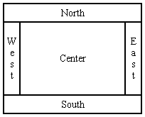
BorderLayout
A BorderLayout has five zones where the components can be added.
Each zone can have only one single Component.
The container’s add() method is used to add the component
It is the default layout manager of Frame and Dialog
import java.awt.*;
class BorderLayoutDemo extends Frame {
Button b1,b2,b3,b4;
TextField txt;
BorderLayoutDemo() {
b1 = new Button("CENTER");
b2 = new Button("EAST");
b3 = new Button("WEST");
b4 = new Button("SOUTH");
txt = new TextField("NORTH");
setLayout(new BorderLayout());
add(b1,BorderLayout.NORTH);
add(b2,BorderLayout.EAST);
add(b3,BorderLayout.WEST);
add(b4,BorderLayout.SOUTH);
add(txt,BorderLayout.CENTER);
}
public static void main(String args[]) {
BorderLayoutDemo demo = new BorderLayoutDemo();
demo.setSize(400,400);
demo.setVisible(true);
}
}
Notes:
When the container is resized each border zone is resized to hold the component. Any excess space is given to the central region
If the add(component) is used then the component is added to the center.
If add(component,Region) is used then component is added to a specific region viz north,south,east,west which are given as constants in BorderLayout
Java Programming Handouts

Slide 14
FlowLayout
FlowLayout arranges components from left to right in a flow
FlowLayout can use multiple rows if the horizontal space in the container is too small to hold the components
It is the default layout manager of Panel and Applet
FlowLayout( )
FlowLayout(int how)
FlowLayout(int how, int horz, int vert)
import java.awt.*;
class FlowLayoutDemo extends Frame {
Button btn[] = new Button[15];
FlowLayoutDemo() {
for(int i=0;i<btn.length;i++) {
btn[i] = new Button(""+i);
add(btn[i]);
}
FlowLayout flow = new FlowLayout(FlowLayout.LEFT,40,40);
setLayout(flow);
}
public static void main(String args[]) {
FlowLayoutDemo demo = new FlowLayoutDemo(); demo.setSize(400,400); demo.setVisible(true); }
}
Notes:
The Layout of the containers can be changed by the programmer by using the containers setLayout() method
Java Programming Handouts

Slide 15
GridLayout
import java.awt.*;
class GridLayoutDemo extends Frame {
Button btn[] = new Button[15];
GridLayoutDemo() {
for(int i=0;i<btn.length;i++) {
btn[i] = new Button(""+i);
add(btn[i]);
}
//GridLayout flow = new GridLayout(3,5);
GridLayout flow = new GridLayout(3,5,10,10);
setLayout(flow);}
public static void main(String args[]) {
GridLayoutDemo demo = new GridLayoutDemo();
demo.setSize(400,400);
demo.setVisible(true);
}
}

Slide 16
Creation of Frame
In AWT, top-level windows are represented by the Frame class
The most common method of creating a frame is by using single argument constructor of the Frame class that contains the single string argument which is the title of the window or frame.
Frame frame=new Frame(“New Window”);
Notes:
The frame in java works like the main window where your components (controls) are added to develop a application .
You can also create a Frame without any Title by using new Frame()
Java Programming Handouts

Slide 17
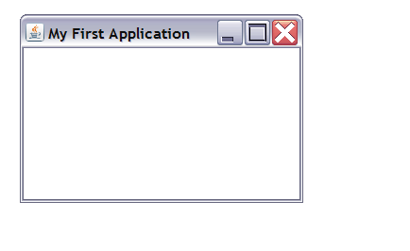
Example of a Frame
import java.awt.*;
public class MyApp
{
Frame frame;
MyApp()
{
frame=new Frame(“My First Application”);
frame.setSize(200,200);
frame.setVisible(true);
}
public static void main(String s[])
{
new MyApp();
}
}
Notes:
Java Programming Handouts

Slide 18
Panel
Panel is the simplest container class. A panel provides space in which an application can attach any other component, including other panels.
The default layout manager for a panel is the FlowLayout layout manager.
Notes:
Panel cannot be displayed on the screen. It has to be placed on a Window Container viz. Frame,Dialog or the Applet container .
Java Programming Handouts

Slide 19
Example of a Panel
import java.awt.*;
public class MyApp extends Frame
{
Panel p1;
MyApp()
{ super("My Application");
p1=new Panel();
p1.setBackground(Color.GREEN);
setBackground(Color.RED);
add(p1,BorderLayout.NORTH);
setSize(200,200);
setVisible(true);
}

Slide 20
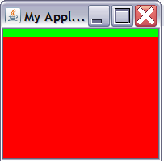
Example (Contd.)
public static void main(String args[])
{
new MyApp();
}
}

Slide 21
AWT Components
Labels:
  Labels provide user prompts, not modified by the user
    Label l=new Label(“Name”);
    Can also specify Label.LEFT/RIGHT/CENTER
    Methods:- getText(), setText(),
    getAlignment(), setAlignment().
Button :
  used to trigger actions and other events required for your application.
  Button button=new Button(“Click”);
  Methods:-getLabel(), setLabel().
Notes:
Java Programming Handouts

Slide 22
AWT Component
Checkbox:
  allows the user to change the state of the component
  Checkbox Checkbox=new Checkbox(“OptionalCheckbox1”);
  Checkbox Checkbox=new Checkbox(“OptionalCheckbox1”, on);
CheckboxGroup (Radiobutton)
  special case of the Checkbox used as a group of checkboxes with same name.
  Only one Checkbox from a Checkbox Group can be selected at a time.
  CheckboxGroup cbg=new CheckboxGroup();
  Checkbox radiobutton1=new Checkbox(“One”,cbg,false);
  Checkbox radiobutton2=new Checkbox(“Two”,cbg,false);
Notes:
Radiobutton:
Only one Checkbox from a Checkbox Group can be selected at a time.
Java Programming Handouts

Slide 23
AWT Component
TextArea
  This is the text container component of Java AWT package.
  This component can contain multiple lines.
  TextArea ta=new TextArea(20,5);
TextField
  This is also the text container component of Java AWT package. This component contains single line and limited text information.
  TextField tf=new TextField(20);
Notes:
You can make the Text Area editable or not using the setEditable (boolean) method. If you pass the boolean valued argument false then the text area will be non-editable otherwise it will be editable. The text area is by default in editable mode. Text are set in the text area using the setText(string) method of the TextArea class.
You can fix the number of columns in the text field by specifying the number in the constructor. In the above code we have fixed the number of columns to 20
Java Programming Handouts

Slide 24
Example of the AWT Components
import java.awt.*;
public class MyApp extends Frame
{
Label feedback,name,hobbies,gender;
Button submit,cancel;
TextArea ta;
TextField tf;
Checkbox cb1,cb2,cb3,rb1,rb2;
CheckboxGroup cbg;
Panel p1,p2,p3,p4,p5;
GridLayout layout;

Slide 25
Example (contd)
public MyApp()
{ super("My First Application");
layout=new GridLayout(5,1);
setLayout(layout);
p1=new Panel();
p2=new Panel();
p3=new Panel();
p4=new Panel();
p5=new Panel();

Slide 26
Example (contd)
feedback=new Label("Feedback");
name=new Label("Name");
hobbies=new Label("Hobbies");
gender=new Label("Gender");
submit=new Button("Submit");
cancel=new Button("cancel");
ta=new TextArea(4,20);
tf=new TextField(20);
cb1=new Checkbox("Reading");
cb2=new Checkbox("Philantropy");
cb3=new Checkbox("Painting")

Slide 27
Example (contd)
cbg=new CheckboxGroup();
rb1=new Checkbox("Male",cbg,false);
rb2=new Checkbox("Female",cbg,false);
p1.add(name);
p1.add(tf);
p2.add(gender);
p2.add(rb1);
p2.add(rb2);
p3.add(hobbies);
p3.add(cb1);
p3.add(cb2);
p3.add(cb3);

Slide 28
Example (contd)
p4.add(feedback);
p4.add(ta);
p5.add(submit);
p5.add(cancel);
add(p1);
add(p2);
add(p3);
add(p4);
add(p5);
setSize(400,400);
setVisible(true);
}

Slide 29
Example (contd)
public static void main(String args[])
{
new MyApp();
}
}

Slide 30
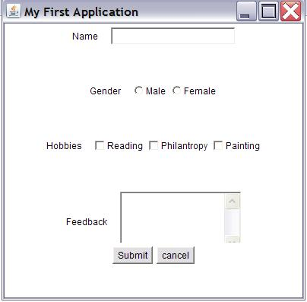
Output of the Example

Slide 31
Test Your Understanding
1. Frame is a subclass of .
  a. Panel
  b. Window
  c. Applet
  d. Dialog`
The default layout of Frame is
a. GridLayout
b.FlowLayout
c. BorderLayout
d. GridBagLayout
Notes:
Java Programming Handouts

Slide 32
Test Your Understanding (contd.)
3. Consider the following code:
  Frame f=new Frame()
  Button b1=new Button(“One”);
  f.add(b1);
  The buttons b1 will be added in
  a. Northern region of the Frame
  b. Southern region of thr Frame
  c. Central region of the Frame
  d. Eastern region of the frame

Slide 33
Test Your Understanding (contd.)
The setVisible(true) method can make a Panel visible
  True
  False
An object that would like to be notified of and respond to an event is an ______________
  Event Listener
  Event source
  Adapter Interface
  Action Class

